Slide 1
Student satisfaction in quality of sports facilities in university of Kelaniya
Survey Method And Sampling Techniques
Group 9

Slide 2

Introduction
The topic explores the current facilities provided to the students who are engaged in sports activities and how it has affected to the student satisfaction and engagement in sports activities and how it has affected to success of sports activities in university of Kelaniya.

Slide 3
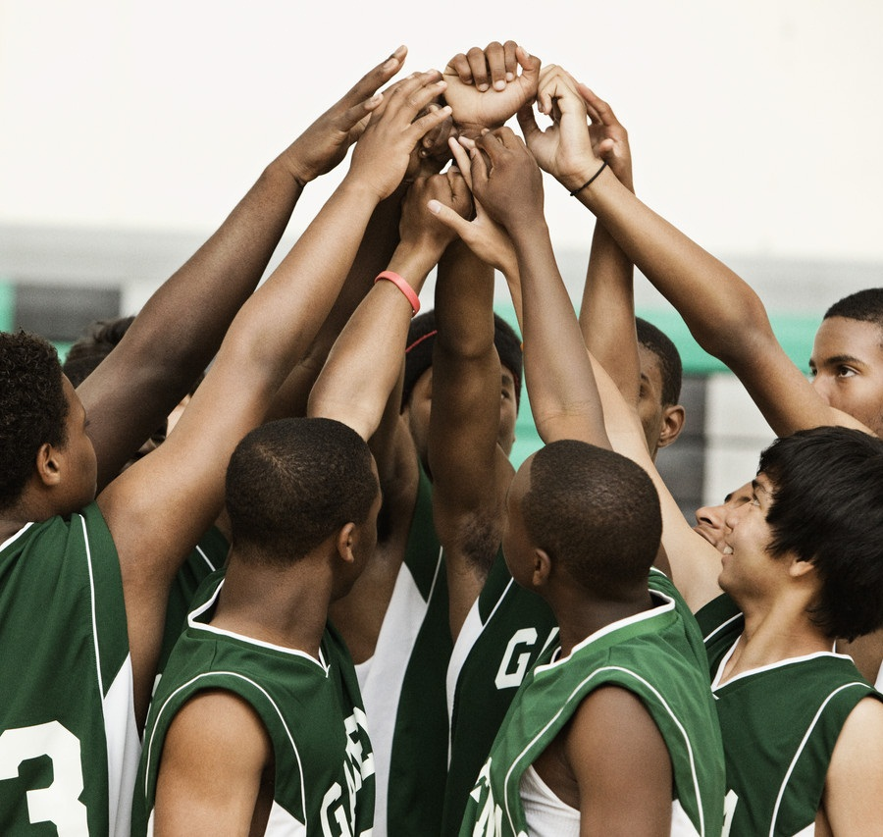
Objective
NOTE:
To change images on this slide, select a picture and delete it. Then click the Insert Picture icon
in the placeholder to insert your own image.
This aims to identify areas for improvement and innovation in sports facilities. This will aid assessing the quality, variety and overall satisfaction with the services provided for sports activities by university. Additionally, this aims to empower the physical and mental wellbeing of university students. Due to a higher fraction of university students suffering from non-infectious diseases and the researchers have concluded that lack of engagement in sports has a direct impact on this issue therefore this study aims to uplift the awareness on the importance of engagement in sports.

Slide 4
Sample Selection Sampling Techniques
Pilot survey - convenience sampling method
Main survey- Stratified random sampling

Slide 5
DATA ANALYSIS

Slide 6
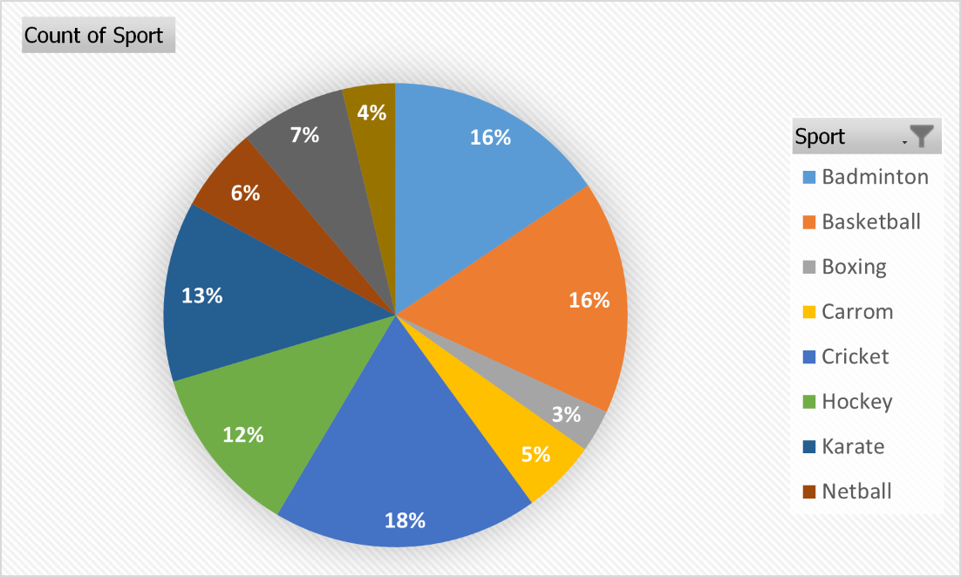
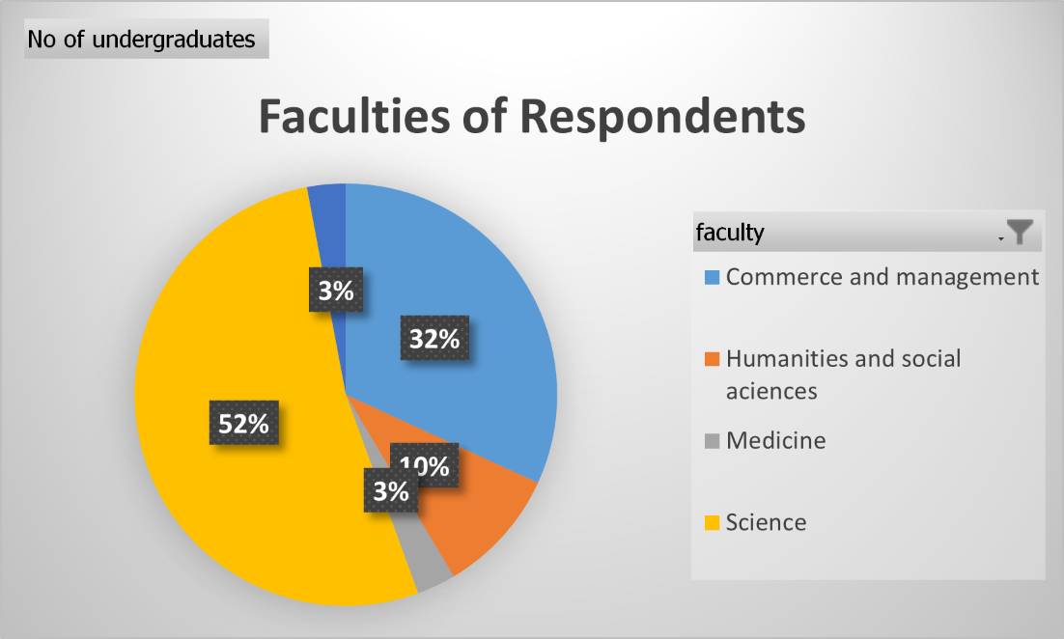
RESPONDENTS’ PARTICIPATION .

Slide 7
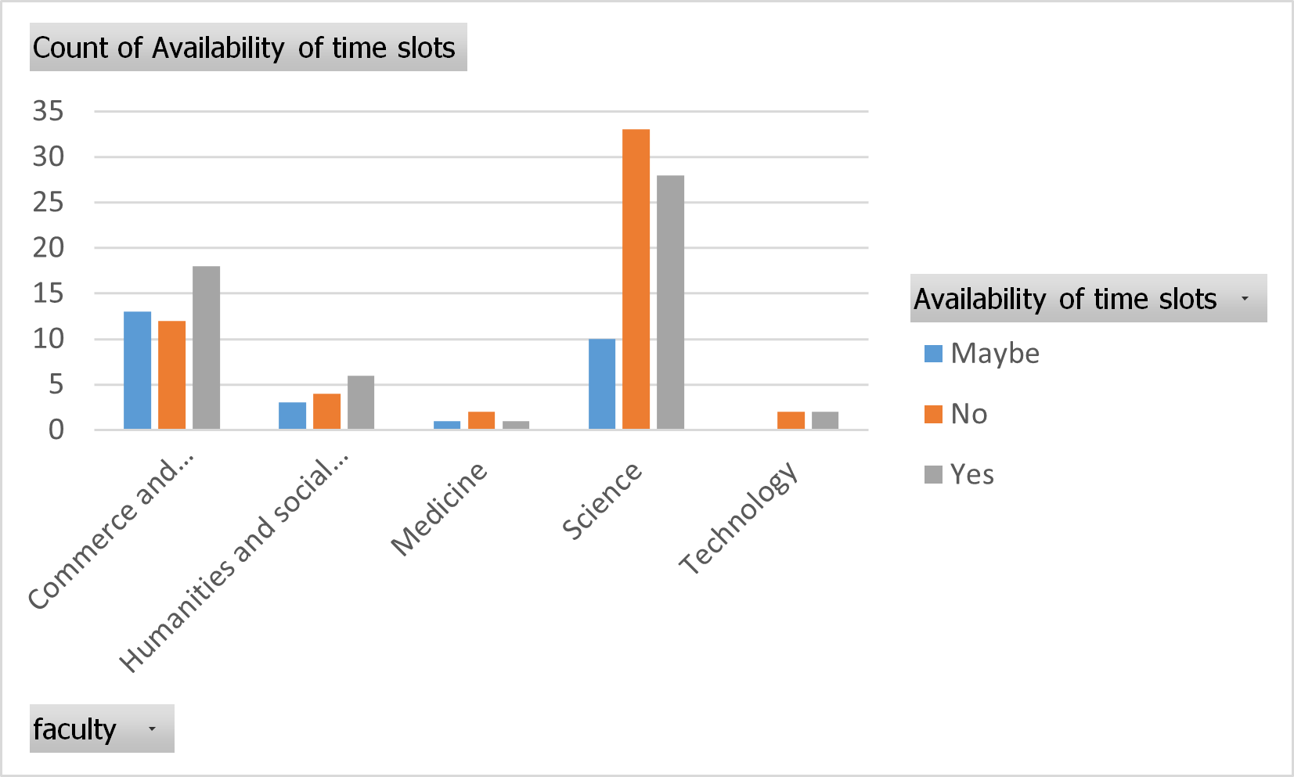
faculty wise availability of time slots.
When comes to faculty of science more number of students dissatisfied about the availability of time slots while commerce and management students have satisfied.

Slide 8
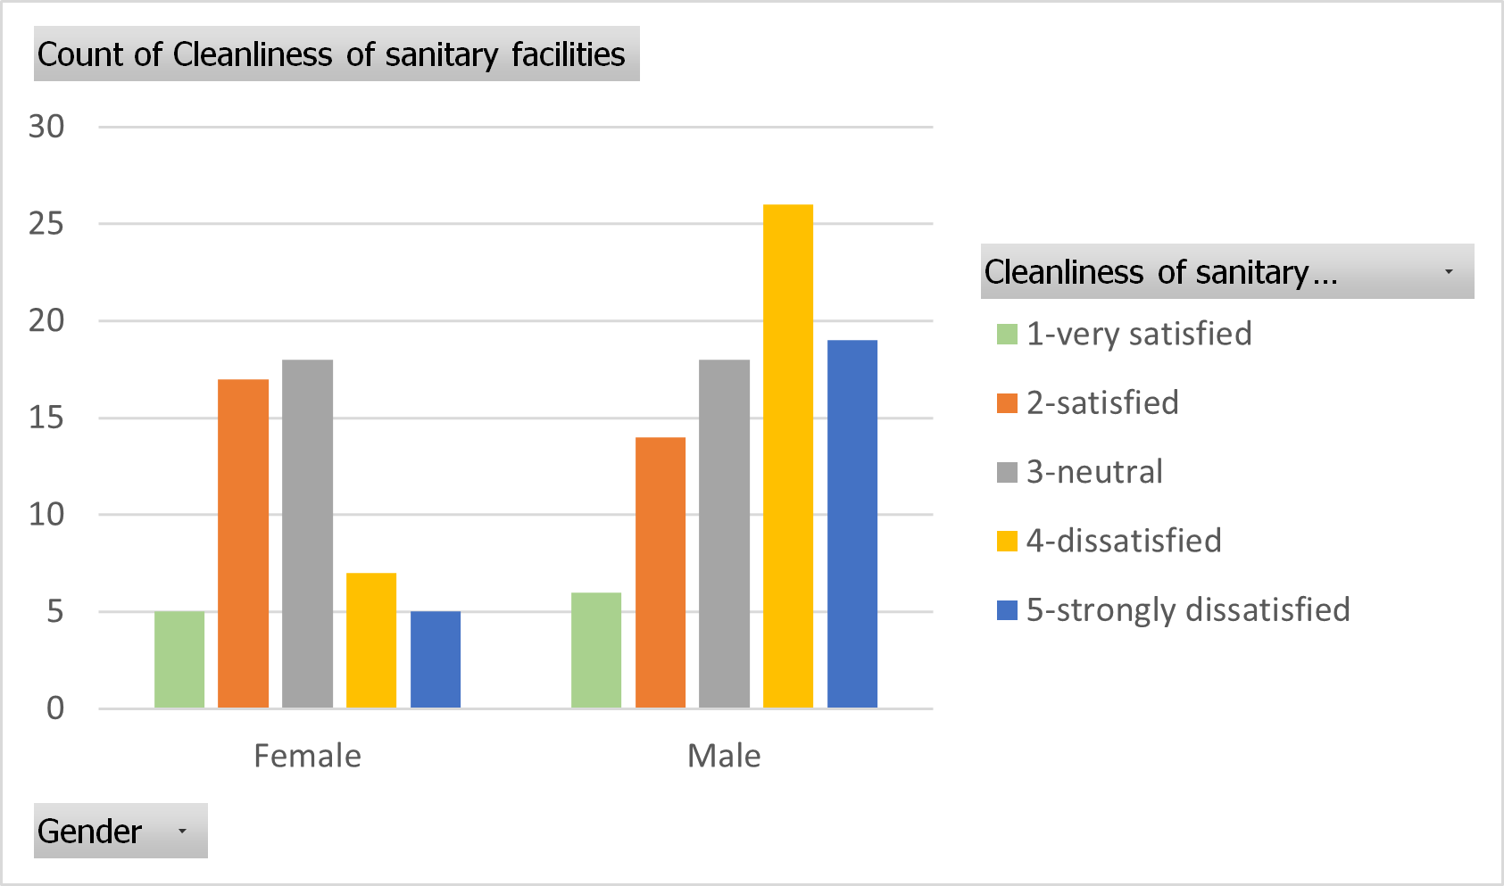
gender wise cleanliness of sanitary facilitie
According to the bar graph we can see that most of the male students are dissatisfied about the given cleanliness and sanitary facilities .

Slide 9
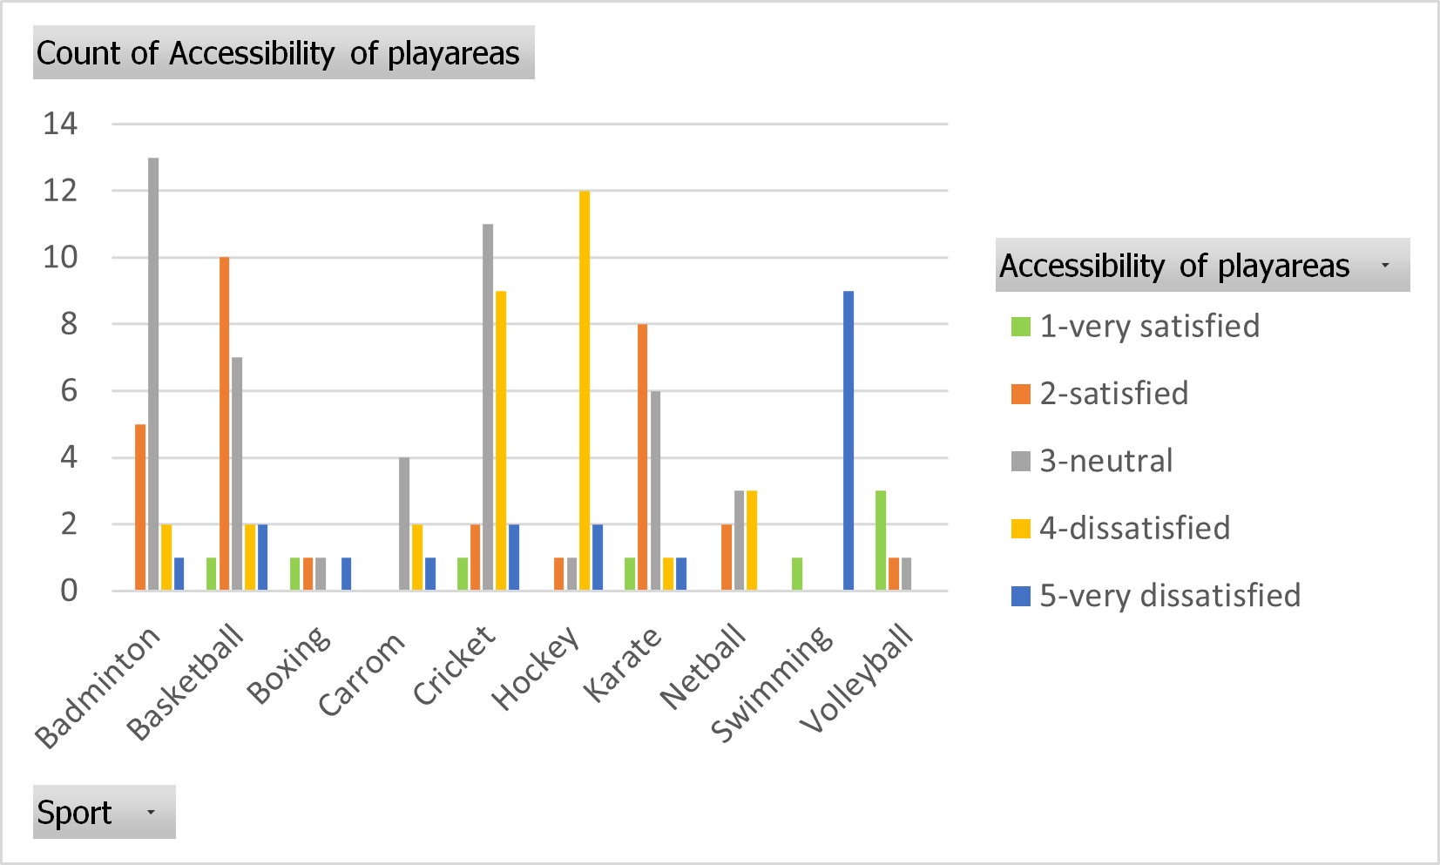
sport wise accessibility of play area.
In swimming we can only see a dissatisfaction among students because they don’t have a swimming pool in the university premises.

Slide 10
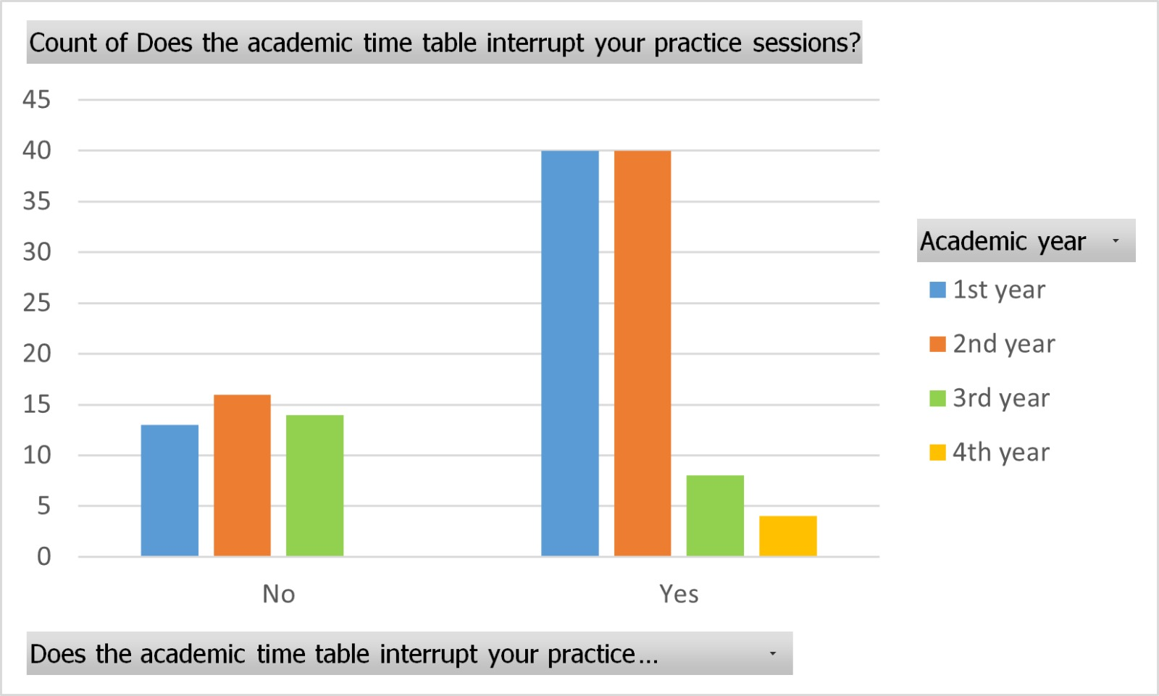
how the practice sessions have interrupted the academics
According to this bar graph we can see that there is a considerable interruption from the acedemic timetable to the students' sport activities for 1st year and 2nd year students.

Slide 11
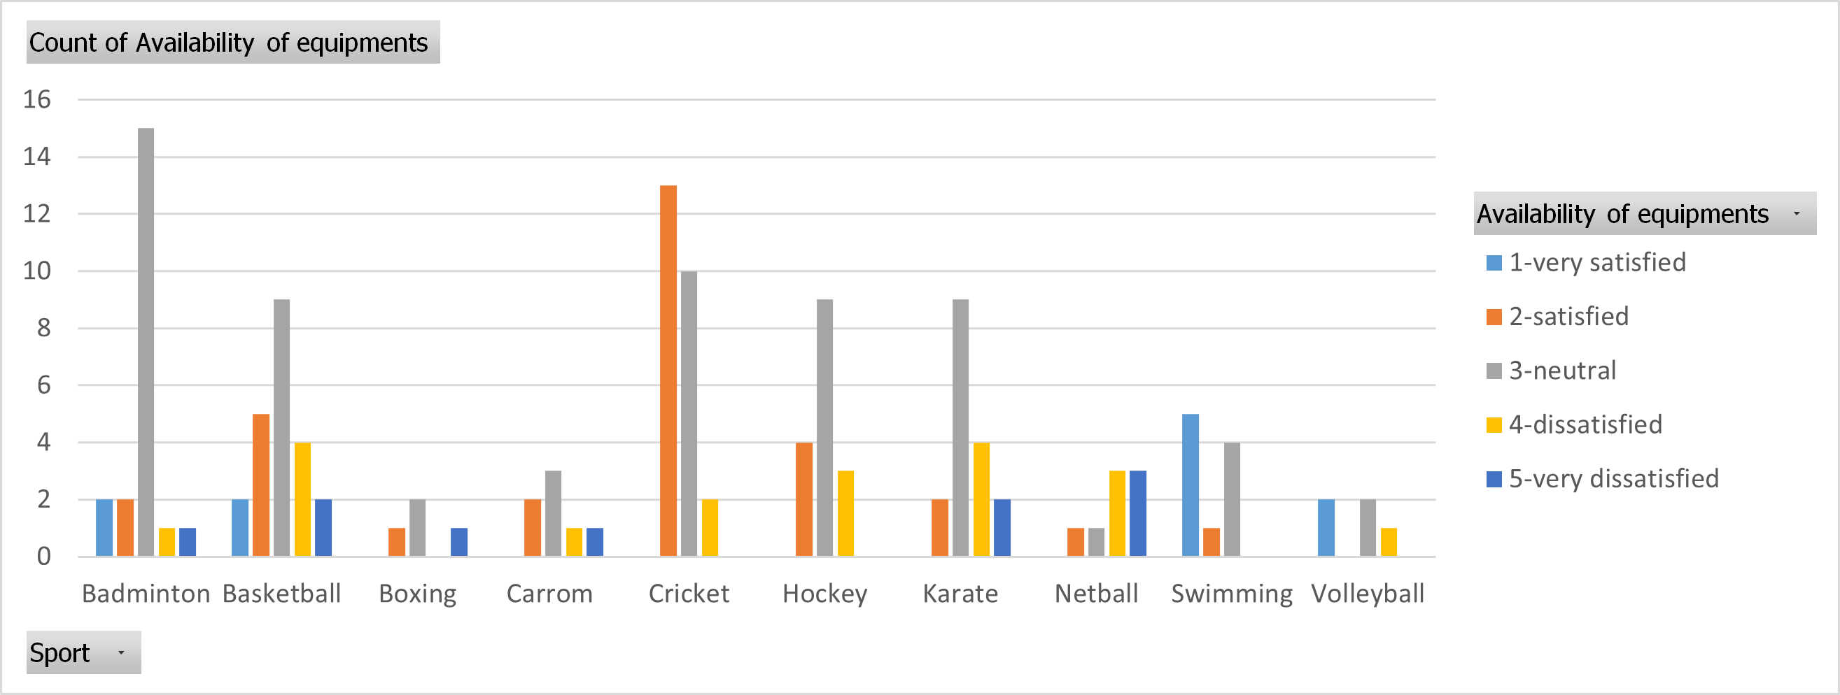
Availability of equipment… We can see that most of the responses are within the area dissatisfied and strongly dissatisfied.

Slide 12
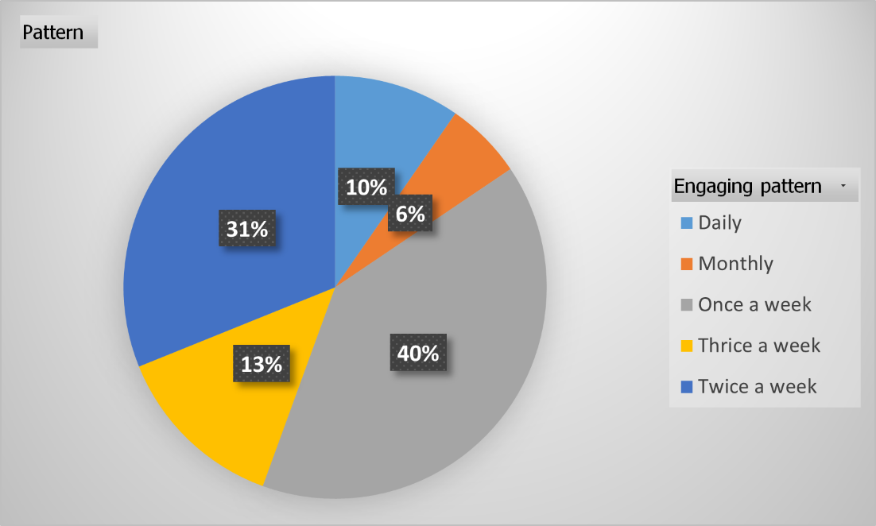
How often students participate in practices…
We can see that most of the students don’t have much time to spend on doing a sport in university of Kelaniya with their academic stuff.

Slide 13
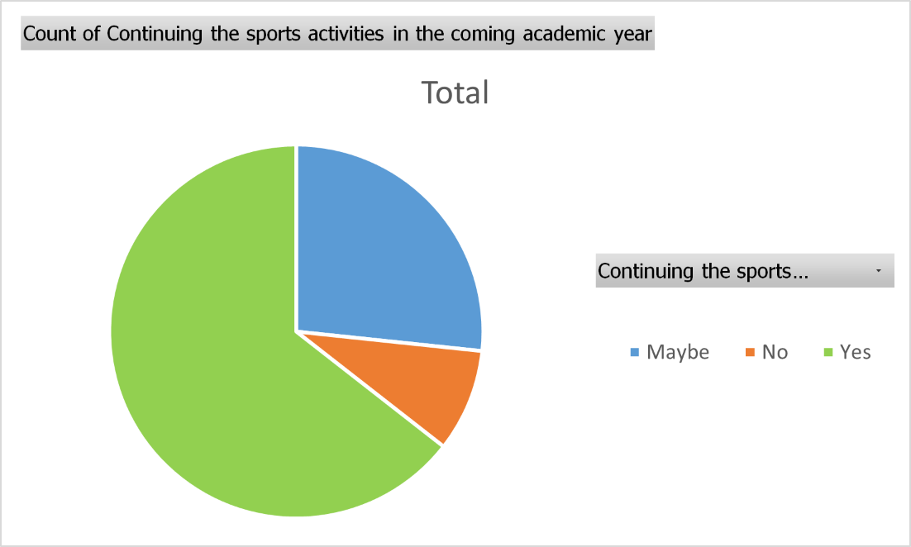
Continuing the sport in the coming years….
According to the pie chart we see that most of the students are willing to continue their sport activities in next academic year onwards.

Slide 14
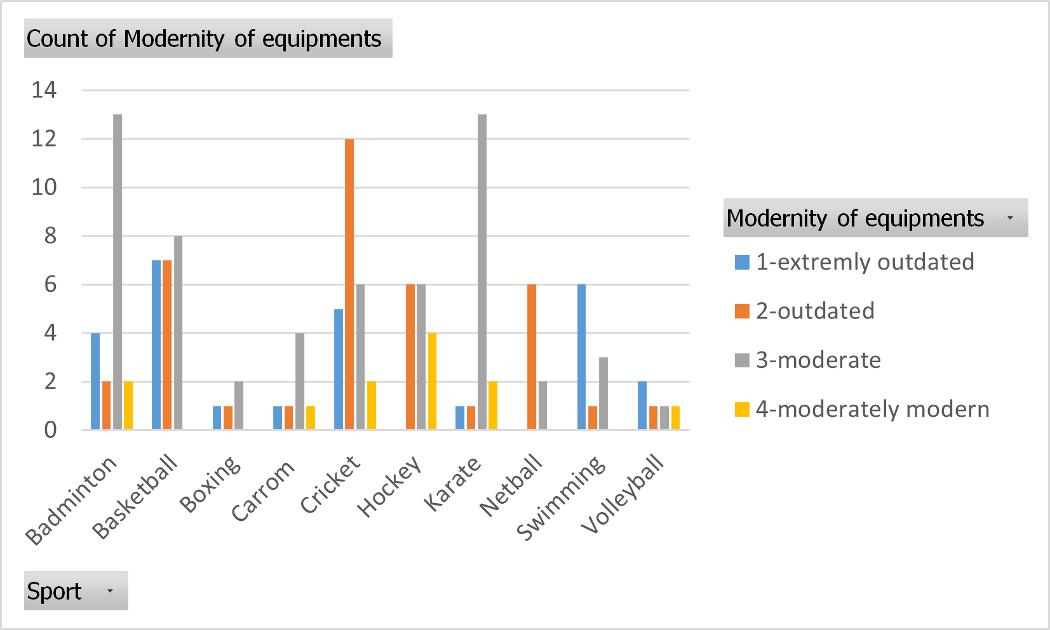
The modernity of equipmentt
we can see that some sports like cricket, basketball and swimming have more equipments of outdated

Slide 15


Discussion and conclusion

Slide 16
Discussion
Most students are satisfied with sports facilities overall.
Satisfaction with sanitary facilities varies; boxing and carrom players are neutral, while females are more satisfied than males.
Cricket and swimming players are satisfied with equipment availability; basketball players are satisfied with equipment modernity, but hockey players are dissatisfied.
First and second-year students are more satisfied with available time slots; science faculty students are dissatisfied.
Most students practice 1-3 hours per session, once a week, indicating overall dissatisfaction with facilities.
Badminton players are dissatisfied with basketball's professionalism; most sports request additional coaching staff.
Swimming and cricket players are dissatisfied with play area accessibility; basketball players are satisfied.
Overall, students are satisfied with the amount of sports events and tournaments organized by the university.

Slide 17

conclusion
When considering all the factors students who are engaged in badminton and basketball are more satisfied about the facilities provided by the university. Hockey, karate, volleyball and netball are the sports which the students are moderately satisfied about the facilities. All the other sports including swimming, cricket, carrom, boxing are the sports which students are more dissatisfied with facilities provided due to difficulty in accessing play areas, lack of professionalism of coaches and lack of modernized equipment.
This Photo by Unknown Author is licensed under CC BY-NC-ND

Slide 18

Summary
Our survey project is Student Satisfaction in Quality of Sports Facilities In University of Kelaniya.
This aims to identify areas for improvement and innovation in sports facilities. This will aid assessing the quality, variety and overall satisfaction with the services provided for sports activities by university.
We were then able to understand which games were the most satisfying, moderately satisfying, and most dissatisfying.

Slide 19

Group members
PS/2020/068 W.W.G.V VINSURA
PS/2020/074 N.C.R GUNARATHNA
PS/2020/147 W.H.H.HAMARASINGHE
PS/2020/186 W.K.S LAKMALI
PS/2020/202 M.A.S.C SIRIWARDHANA
PS/2020/207 P.M.K.D WIMARSHANA
PS/2020/210 G.J CHINTHANI
PS/2020/213 H.M.T.D RANASINGHE
PS/2020/258 N.D.K NADEESHA
C

Slide 20

Thank you

